Slide 1
Commission calculator
A repackaged solution

Slide 2
Overview
Given data, produce a report indicating sales and commissions for sales agents
Input
Sales person file
Sales performed

Slide 3
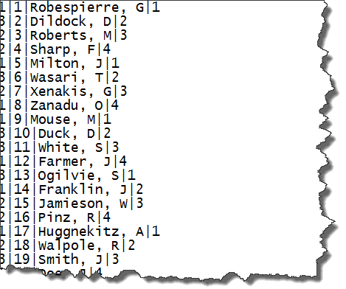
Employees
Weekly base pay:
Level 1: $100
Level 2: $150
Level 3: $200

Slide 4
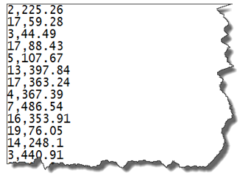
Weekly sales

Slide 5
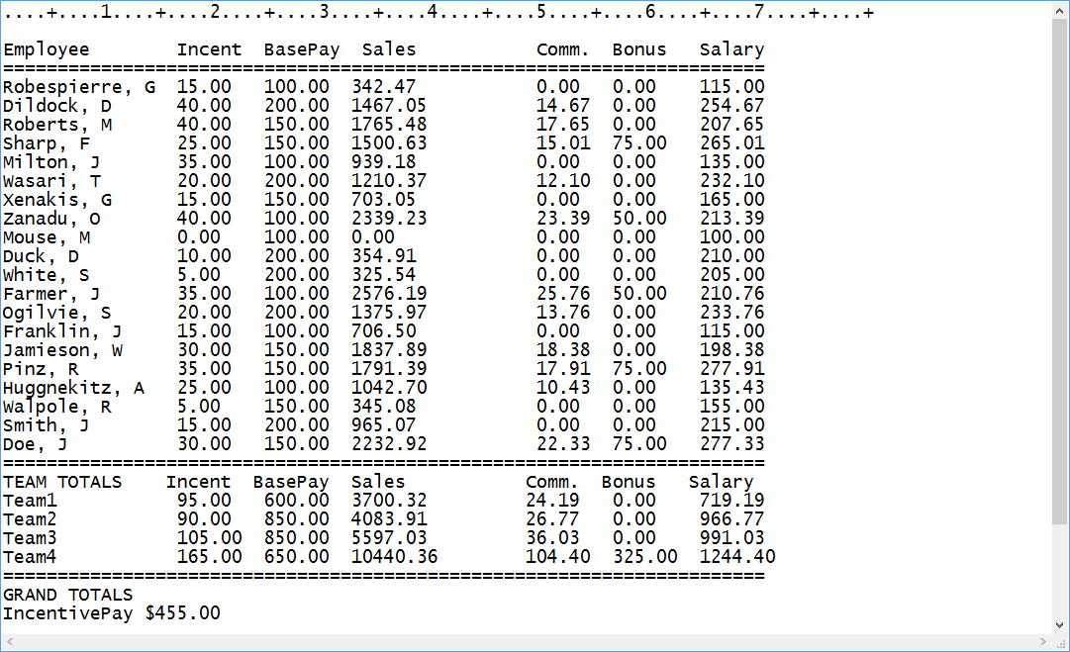
Report

Slide 6
Additional information
Commission:
Level 1: 1% of the associate’s sales
Level 2: 2.25% of the associate’s sales
Level 3: 3.5% of the associate’s sales
In addition, all associates belonging to the Team which sells the most (raw dollar amount) receives a bonus:
Level 1: $50
Level 2: $75
Level 3: $100
Changes to the report above:
Alter the report to show amount (payments) as ‘right-aligned’ so that the decimal point lines up

Slide 7
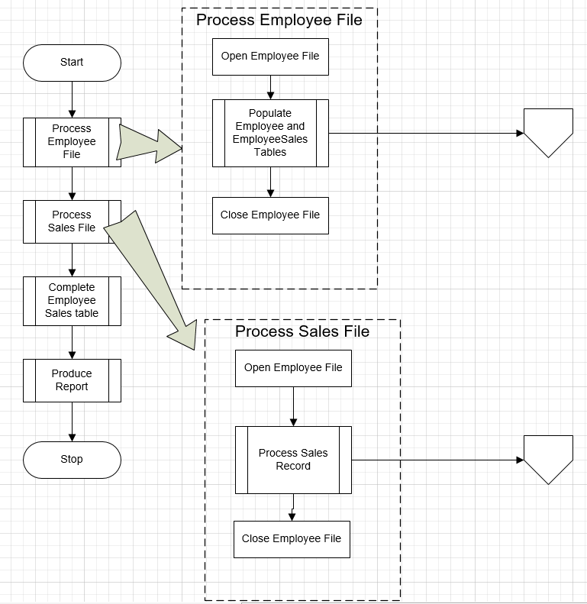
The plan
High level flowchart

Slide 8
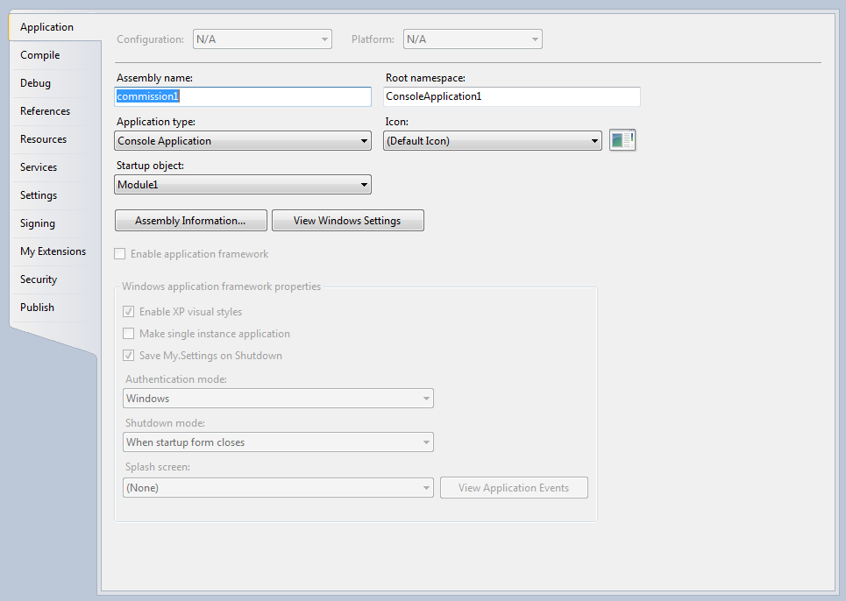
Project Properties
In the solution explorer
Locate the tab for the entire project and open it
Provides several settings
Icon to present to user
Startup Object
In this case Module1

Slide 9
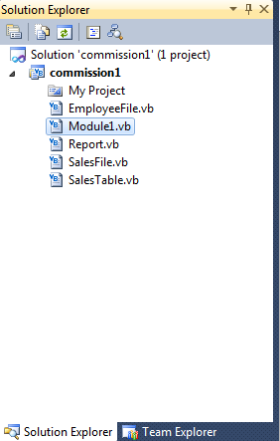
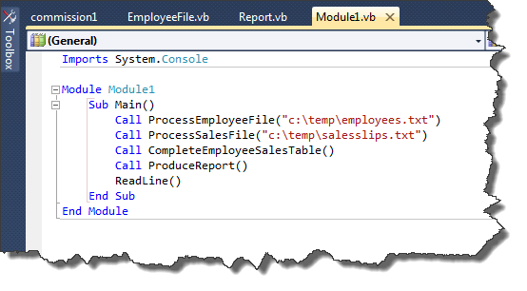
Modularity
In this version:
Program is segmented into functional components
Each piece occupies its own ‘module’
Ends in ‘.vb’

Slide 10
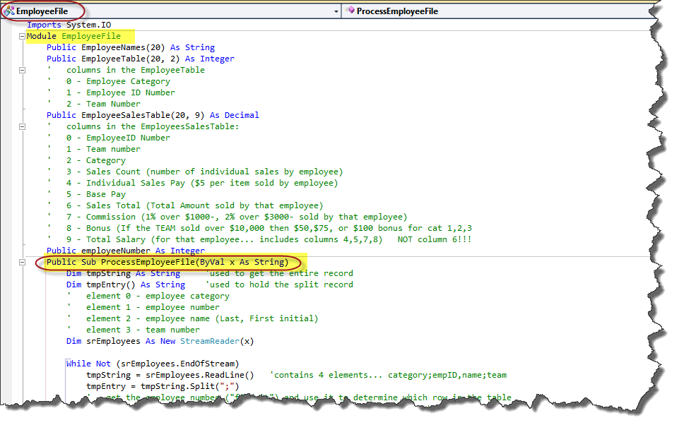
ProcessEmployeeFile
Resides in the EmployeeFile.vb module

Slide 11
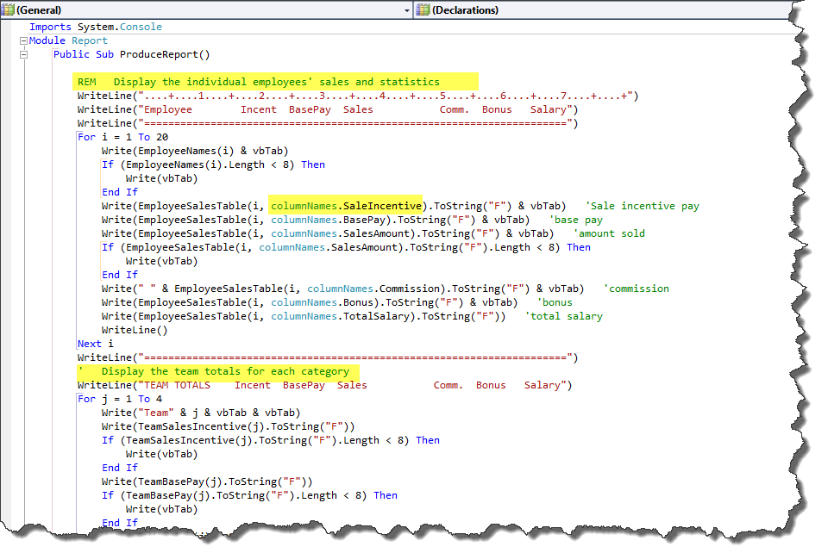
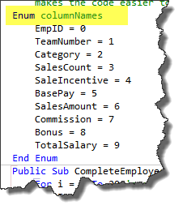
ProduceReport method
Writes a header
Loops through the table to print specific lines in the report
Each line uses a “friendly” reference to the column instead of the number
Part of an enumeration “collection” where each item in the ‘columnNames’ collection has an associated value

